Slide 1
Magistrate Judges Best Practices Forum
May 17, 2024
Mahoney State Park, Ashland, NE

Slide 3
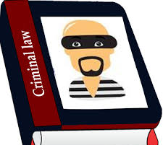
Criminal case progression
Pretrial Motions
Status Conferences
Trial Continuances
Release for Treatment
Cooperation Cases

Slide 4
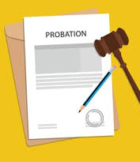
U.S. Probation and Pretrial Services
First Step Program
Pretrial Supervision
Pretrial Risk Assessment (PTRA)
Provision of Shelter

Slide 5
United States Marshals Service
Defendant placement and transportation
Attorney/client communication

Slide 6
Title and manner of addressing a United States Magistrate Judge
The title magistrate no longer exists in the U.S. Courts, having been changed from “magistrate” to “magistrate judge” in 1990. Judicial Improvements Act of 1990, Pub. L. No. 101-650, §321, 104 Stat. 5089 (1990) (“After the enactment of this Act, each United States magistrate . . . shall be known as a United States magistrate judge.”). See Ruth Dapper, A Judge by Any Other Name? Mistitling of the United States Magistrate Judge, 9 Fed. Courts L. Rev. 1, 5-6 (2015). Accordingly, the word “magistrate” is no longer appropriately used as a noun in federal courts, but only as an adjective, indicating the type of judge to which one is referring. Case law sometimes uses the term “magistrate,” perhaps because some cases may involve “magistrates” as defined under pertinent state law or because the case law predates the 1990 change in title, but at other times just out of carelessness in reference to federal magistrate judges. In the latter case, it is the equivalent of calling a district judge “district,” a bankruptcy judge “bankruptcy,” a circuit judge “circuit,” or perhaps just as inappropriately, a lieutenant general “lieutenant.” Thus, the correct salutation is either “Magistrate Judge” or simply “Judge.”
Title and Manner of Addressing a United States Magistrate Judge
The official title of these judges is “United States Magistrate Judge.”
To be consistent with the position’s judicial role and official title as prescribed by law, a United States Magistrate Judge should be addressed, orally and in writing, as “Judge.”
Although some state courts have a judicial officer called a “magistrate,” that title as applied to a United States Magistrate Judge is obsolete. Because the word “magistrate” is merely descriptive of the type of judge, to address a Magistrate Judge simply as “Magistrate” is akin to improperly addressing a Lieutenant Colonel as “Lieutenant,” or a Bankruptcy Judge as “Bankruptcy.”
There is no such thing as a Magistrate Court. A magistrate judge is a judge of the District Court.

Slide 7
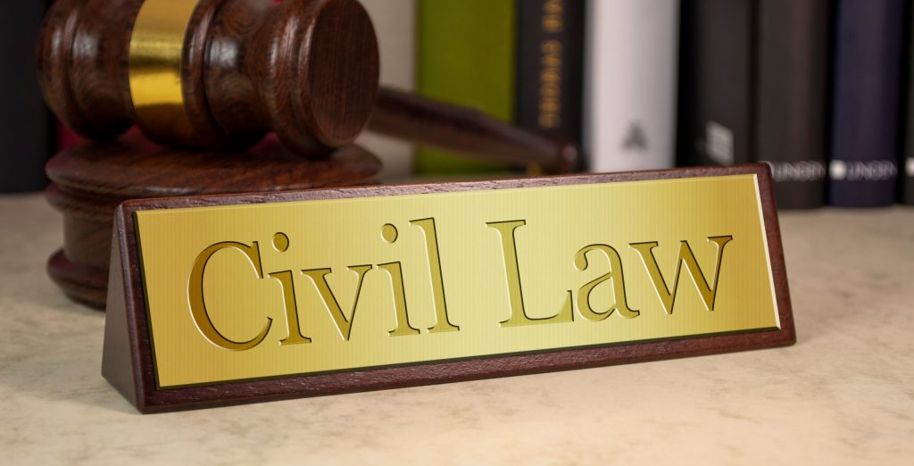

Slide 8
Discovery issues
Written Discovery Requests
30(b)(6) Depositions
Discovery Dispute Process

Slide 9
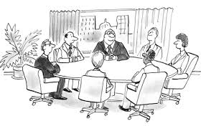
Settlement conferences

Slide 10
Case Progression

Slide 11
Magistrate judge consent
Process
Considerations

Slide 12
Title and manner of addressing a United States Magistrate Judge
The title magistrate no longer exists in the U.S. Courts, having been changed from “magistrate” to “magistrate judge” in 1990. Judicial Improvements Act of 1990, Pub. L. No. 101-650, §321, 104 Stat. 5089 (1990) (“After the enactment of this Act, each United States magistrate . . . shall be known as a United States magistrate judge.”). See Ruth Dapper, A Judge by Any Other Name? Mistitling of the United States Magistrate Judge, 9 Fed. Courts L. Rev. 1, 5-6 (2015). Accordingly, the word “magistrate” is no longer appropriately used as a noun in federal courts, but only as an adjective, indicating the type of judge to which one is referring. Case law sometimes uses the term “magistrate,” perhaps because some cases may involve “magistrates” as defined under pertinent state law or because the case law predates the 1990 change in title, but at other times just out of carelessness in reference to federal magistrate judges. In the latter case, it is the equivalent of calling a district judge “district,” a bankruptcy judge “bankruptcy,” a circuit judge “circuit,” or perhaps just as inappropriately, a lieutenant general “lieutenant.” Thus, the correct salutation is either “Magistrate Judge” or simply “Judge.”
Title and Manner of Addressing a United States Magistrate Judge
The official title of these judges is “United States Magistrate Judge.”
To be consistent with the position’s judicial role and official title as prescribed by law, a United States Magistrate Judge should be addressed, orally and in writing, as “Judge.”
Although some state courts have a judicial officer called a “magistrate,” that title as applied to a United States Magistrate Judge is obsolete. Because the word “magistrate” is merely descriptive of the type of judge, to address a Magistrate Judge simply as “Magistrate” is akin to improperly addressing a Lieutenant Colonel as “Lieutenant,” or a Bankruptcy Judge as “Bankruptcy.”
There is no such thing as a Magistrate Court. A magistrate judge is a judge of the District Court.

